Slide 1
Applied Data Science Logistic Regression
Dr. Omri Allouche
2017

Slide 2
Homework
Perform EDA of the OkCupid dataset https://github.com/rudeboybert/JSE_OkCupid
Use Jupyter Notebook, combining markdown, code and graphs
Use appropriate headings and sections
Choose the best graph for the job
Explain what the graph shows
Submit notebook as a Pull Request. Name the file YOURID_YOURNAME_EDA_OkCupid.ipynb
Read Example Machine Learning Notebook until Step 5 (Classification) – not including
Read Visualization with Seaborn

Slide 3
Logistic regression
Despite the name, is used for Classification, not Regression.
Can be extended to multiclass classification.

Slide 4
Odds Ratio

Slide 5


Logistic Function
Sigmoid function
Inverse of the Logit function

Slide 6
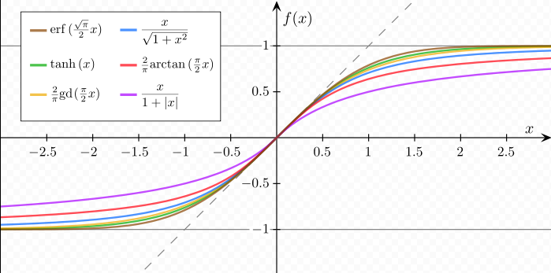
Sigmoid Functions
Notes:
all functions are normalized in such a way that their slope at the origin is 1.

Slide 7
Data visualization Guidelines

